Slide 2
The process of taking a background check is determined by the rules in your local association.
The following associations require the background check to be paid with the team’s registration invoice…
CA – Central California ASA
CA – Sacramento ASA
CA – Southern California ASA
HI – Hawaii ASA
MT – Montana ASA
OR – Oregon ASA
UT – Utah ASA
If you are in one of these associations and you are attempting to login, please have your Team Administrator send you a welcome email. Your Team Administrator can send you a welcome email by clicking on your name on the team’s page and clicking the “Send Welcome Email” button.

Slide 3
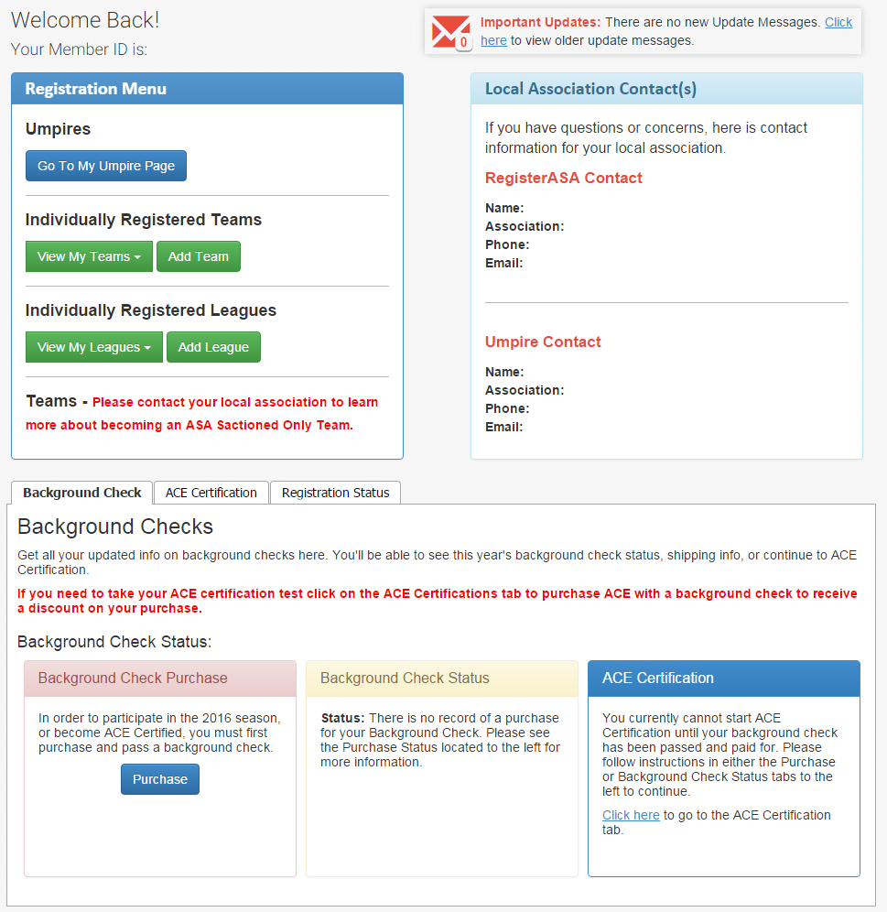
Select Background Check tab and click on “Purchase” button.

Slide 4
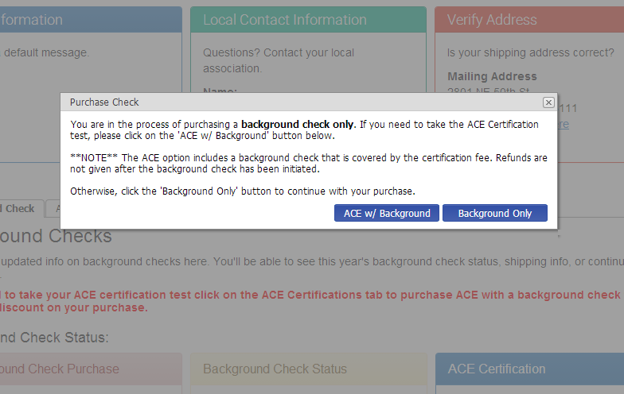
Make sure you are needing a background check only. If you are needing to do an ACE certification then select the ACE w/ Background button

Slide 5
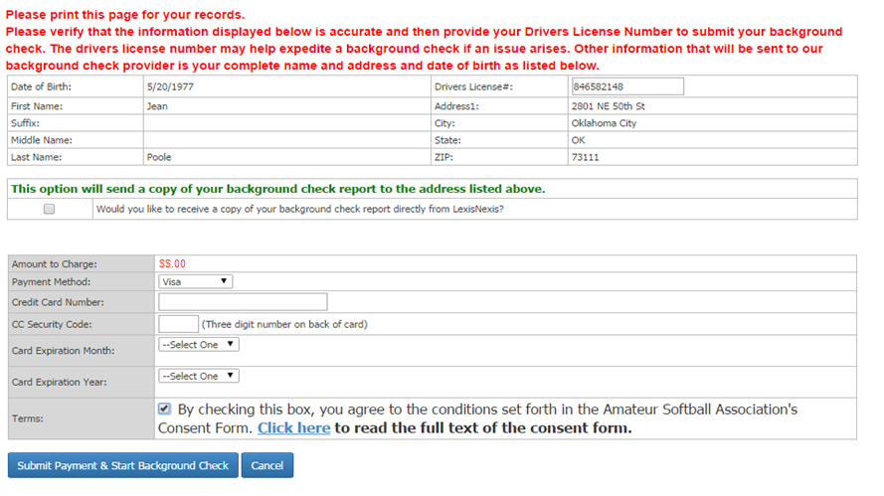
Fill out all of the boxes. To consent to your background check, click the checkbox.

Slide 6
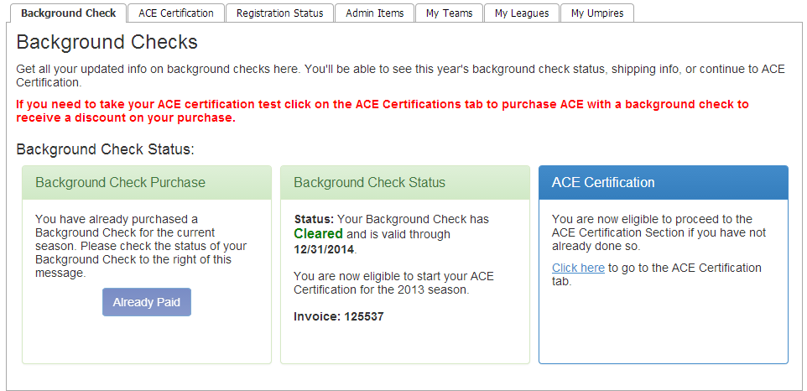
To check the status of a Background Check, login and view the Background Check Status box under the Background Check tab.

